Slide 1
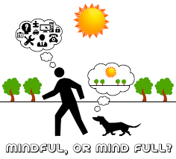
MINDFUL OR MIND FULL?
THE ROLE OF MINDFULNESS
IN STUDENT SUCCESS
Katherine LeRoy
Assistant Director - Academic Support Services
Samuel Merritt University

Slide 2
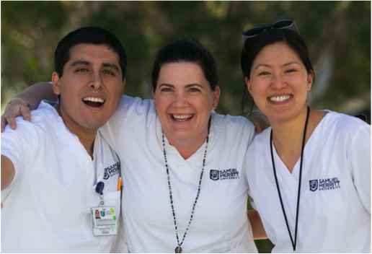
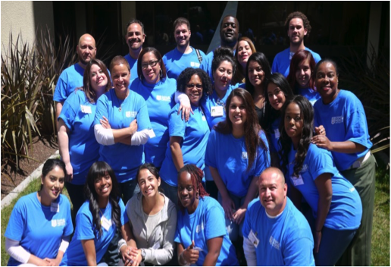

Slide 3
SACRAMENTO
OAKLAND
SAN MATEO
ACTLA--SAN DIEGO

Slide 4
Academic Programs
School of Nursing | Graduate Health Professions
Bachelor of Science in Nursing
Accelerated Bachelor of Science in Nursing | Occupational Therapy (OTD)
RN to BSN | Physical Therapy (DPT)
Entry Level Master of Science in Nursing FNP and Case Management | Physician Assistant (MPA)
Master of Science in Nursing FNP, CRNA and Case Management | Podiatric Medicine (DPM)
Doctor of Nursing Practice DNP and DNP-FNP

Slide 5
Founded in 1909 - Nursing
WASC accredited
Private, not-for-profit
1,900 students

Slide 6
Average graduation rate: 95%
1st time licensure pass rates: 85-95%
Employment rate within 1 year of graduation: 97%

Slide 7
Academic Resource Center
Academic coaching
Peer Tutoring program
Academic Success workshops

Slide 8
MINDFULNESS: WHAT?
The practice of being aware of your body, mind, and feelings in the present moment.
(Cambridge Dictionary)

Slide 9
MINDFULNESS: WHAT?
Mindfulness is the basic human ability to be fully present, aware of where we are and what we’re doing, and not overly reactive or overwhelmed by what’s going on around us.
(Mindful.org)

Slide 10
MINDFULNESS: WHAT?
Jon Kabat-Zinn
University of Massachusetts
Medical School
Mindfulness-Based Stress Reduction (MBSR)

Slide 11
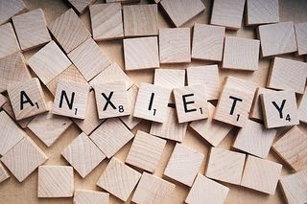
Psychology Today
(June 2017)
The Anxiety Epidemic

Slide 12
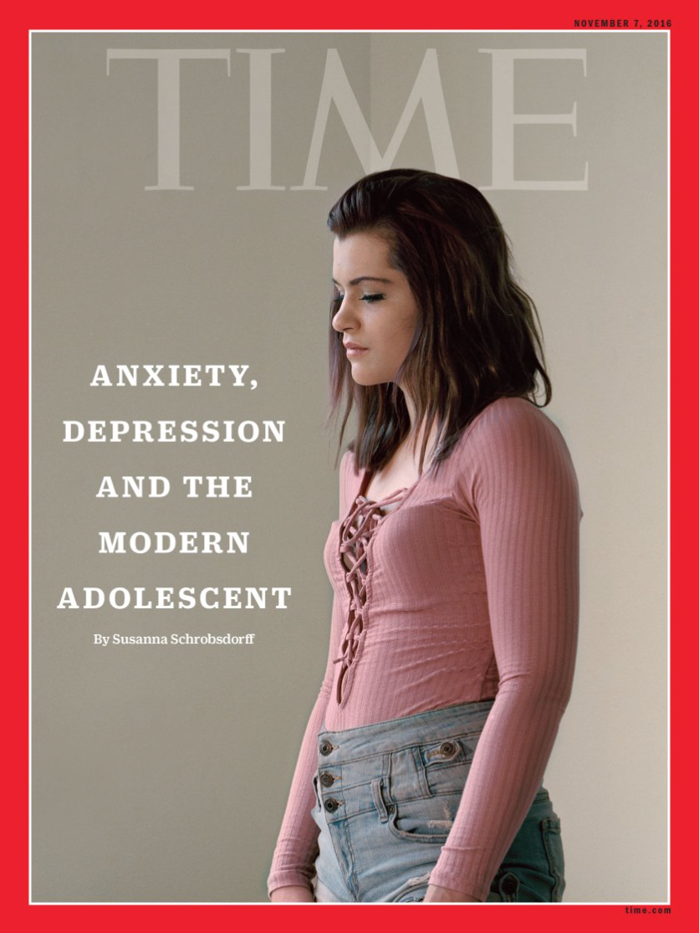
Time Magazine
(November 2016)
Anxiety, Depression &
The Modern Adolescent

Slide 13
The Chronicle of Higher Education
(Feb 2018)
“I Didn’t Know How to Ask for Help”: Stories of Students With Anxiety

Slide 14
Time Magazine
(March 2018)
Record Numbers of College Students Are Seeking Treatment for Depression and Anxiety –
But Schools Can’t Keep Up

Slide 15
Penn State University’s
Center for Collegiate Mental Health
2017 Annual Report

Slide 16
Data from more than 100,000 students treated at student health centers across the country
61% reported anxiety as major health concern
“Academic Performance” cited as one of the top five causes of this anxiety

Slide 17
2015 National College
Assessment Survey

Slide 18
Largest known comprehensive data set on the health of college students
56.9% of students reported feelings of overwhelming anxiety sometime in the past year

Slide 19
One-third of students reported experiencing those feelings within the previous month
53.5% of students described feeling “tremendous” stress within the past year

Slide 20
Overall, 1 in 6 students said they’d been treated for serious anxiety within that same year

Slide 21
STRESS & ANXIETY
Healthy stress is a natural part of student life and can be a motivating factor
Can be displaced by toxic stress
when life’s demands outpace the ability to cope

Slide 22
EFFECTS OF STRESS
Toxic stress taps into deep-seated “fight-or-flight” reactions
Leads to a mismatch between the severity of the stimulus and the response

Slide 23
MINDFULNESS: WHY?
SCIENCE + MINDFULNESS = CONTEMPLATIVE NEUROSCIENCE

Slide 24
University of Massachusetts:
Division of Mindfulness
“…further the scientific knowledge of mindfulness and of how
the mind works.”

Slide 25
MINDFULNESS: WHY?
Greater Good Magazine:
Science-Based Insights for a Meaningful Life
(https://greatergood.berkeley.edu/resources/studies)

Slide 26
MINDFULNESS: WHY?
Mindfulness changes our brains
Research has found that it increases density of gray matter in brain regions linked to learning, memory, emotion regulation, and empathy.

Slide 27
HIPPOCAMPUS =
Learning, Memory
AMYGDALA =
Fear, Anxiety, Stress

Slide 28
MINDFULNESS: WHY?
Mindfulness helps us deal with stress
Evidence suggests that mindfulness training lowers stress hormones and can especially help people in high-stress situations.

Slide 29
Deep Breathing: physiologically calming
Breath Awareness: focus on the “now” vs. a future outcome
Mindfulness Meditation: identifying negative thinking

Slide 30
MINDFULNESS: WHY?
Mindfulness helps us focus
Studies suggest that mindfulness helps us tune out distractions and improves our attention skills and decision-making.

Slide 31
DEFAULT MODE NETWORK =
Mind-wandering
Self-referential thoughts

Slide 32
MINDFULNESS AT SMU
Academic coaching
Breathing awareness
Focused attention = recognize negative thought patterns

Slide 33
MINDFULNESS AT SMU
Academic coaching
Referrals for counseling
(The SHAC)
Share research studies
Mindfulness resources

Slide 34
MINDFULNESS APPS
Insight Timer
Meditation timer tool that also includes playlists and guided meditations, as well as a social aspect—you can see who else is meditating at the same time and keep notes about each meditation.
Headspace
Helps you learn the basics of breathing and visualization in short easy-to-access lessons.
Stop, Breathe & Think
Easy, practical tools for meditation and positive thinking.
10% Happier: Meditation for Fidgety Skeptics
Clear simple approach to meditation from a range of well-respected teachers

Slide 35
MINDFULNESS AT SMU
Peer Tutors
Course specific support
Stress Management = tutors share best practices

Slide 36
MINDFULNESS AT SMU
Collaborative partners
Student Body Association (SBA)
Active Minds
Wellness Club
Faculty
The SHAC (Health & Counseling)

Slide 37
MINDFULNESS AT SMU
Collaborative events
Weekly yoga/meditation classes

Slide 38
FREE STUDENT-LED CLASSES
12-12:30pm
Tues/Wed: Guided meditation
Thurs: Yoga

Slide 39
MINDFULNESS AT SMU
Collaborative events
Weekly yoga/meditation classes
Mindfulness panels

Slide 40
MINDFULNESS PANEL
Emily Spaeth (PT student – yoga and movement)
Ariel Ross (PT student – yoga)
Rebecca Pell (ELMSN student – meditation)
Daniel Jolles (PT student – meditation & pranayama)
Kathryn Kim (Nursing faculty - creative arts, aromatherapy)
Jason Hardage (PT faculty - yoga and meditation)

Slide 41
MINDFULNESS AT SMU
Collaborative events
Weekly yoga/meditation classes
Mindfulness panels
Day of Mindfulness

Slide 42
BI-ANNUAL DAY OF MINDFULNESS
Activity corners: Yoga, meditation, tai chi, pilates
Free chair massage
Affirmation wall
Creativity table: coloring book, play-doh, beading
Therapy animals
DIY aromatherapy and bath “teas”
Healthy snacks
Info tables: stress reductions tips, healthy sleep, signs of depression, mental health resources

Slide 43
MINDFULNESS AT SMU
Collaborative events
Weekly yoga/meditation classes
Mindfulness panels
Day of Mindfulness
Special presentations

Slide 44
Developing a Health Pro Mindset
Katie Tietz, MS, OTR/L – Mindset Coach and bestselling author
During this 2 hour workshop you will learn strategies for improving self-awareness and mindfulness based practices.

Slide 45
Integrating Yoga & Mindfulness:
Exploring the Possibilities
Liz Gillem Duncanson, DPT –
Founder, Body Temple Physical Therapy
Yoga is a sophisticated, multi-dimensional form of exercise that encompasses not only physical postures
but also breathing exercises and meditation.
Taken together, these elements can improve not only strength, flexibility, balance, aerobic capacity, power, and agility,
but also posture, body awareness, mindfulness, and mood.

Slide 46
Mindful Movement:
Incorporating Mindfulness into our Busy Lives
Emily Spaeth, CMT, E-RYT – Physical Therapy student
You will walk away from this short presentation with tangible strategies to enhance your body awareness and increase your tolerance for stressful situations. You will also learn about some of the evidence supporting mindfulness for improving overall health, productivity, and happiness.

Slide 47
Motion, Music & Mindfulness:
The Three M’s to Thrive!
Uzo Nwankpa, MSN, RN – Nursing faculty
Connect the ancient soul with the body using a combination of intentional movement, music and the breath.
Be prepared to move the body!

Slide 48
Meditation:
More heart, more resilience, more inspiration
Charles Ryan - ABSN student & meditation instructor
The more you get to know yourself inside,
the more you can make choices and optimize yourself
to be anything you want to be.
This will be an experiential and interactive talk
with 2+ short meditations included.

Slide 49
SMU Health & Wellness
Institutional Learning Outcome #8:
Demonstrate the ability to care for self, specifically in the physical, emotional, and spiritual realms, in order to increase career satisfaction and effectiveness.

