Slide 1
Online Tutoring: Complementing, Not Competing with On-Campus Tutoring
Barbara Illowsky, PhD
Chief Academic Affairs Officer
CCC Online Education Initiative
Foothill-De Anza CCD
billowsky@cccOnlineEd.org
@DrBSI

Slide 2
Who’s here?
Tutoring Center coordinators
Tutors
Faculty
Administrators
Support staff
Researchers
Everyone else

Slide 3
CCCOEI Mission: Increase student
COMPLETION of transfer degrees by working together to increase access to quality online courses and support services for students.

Slide 4
Access | Quality | Completion
Providing resources to colleges to allow for the addition of quality online courses
Improve success and retention
----- Prepared students
----- Prepared faculty
----- Quality course design and content resources
Providing students with opportunities to take classes when and where they need them

Slide 5
Online Learning Support Ecosystem
Online Readiness (Quest Program)
Prof. Development & Course Design Rubric
Coordinated Online Library Services
Online Counseling Network & Platform
Online Test Proctoring
Common Course Management System
Embedded Support for High Risk Students
Accessibility Support & Universal Design
Online Tutoring 24x7
& Platform

Slide 6
Additional Support Resources
Student online readiness program, includes multimedia tutorials, SmarterMeasure diagnostic
Tutoring service 24/7 free to pilot colleges (20% cost savings for non-pilot colleges)
Online Counseling Network (PD and community using NBCC standards for distance counseling)
Online proctoring tool free to pilot colleges (20% cost savings for non-pilot colleges)
Online plagiarism detection tool free to subset of pilot colleges (46% savings to non-pilot colleges)

Slide 7
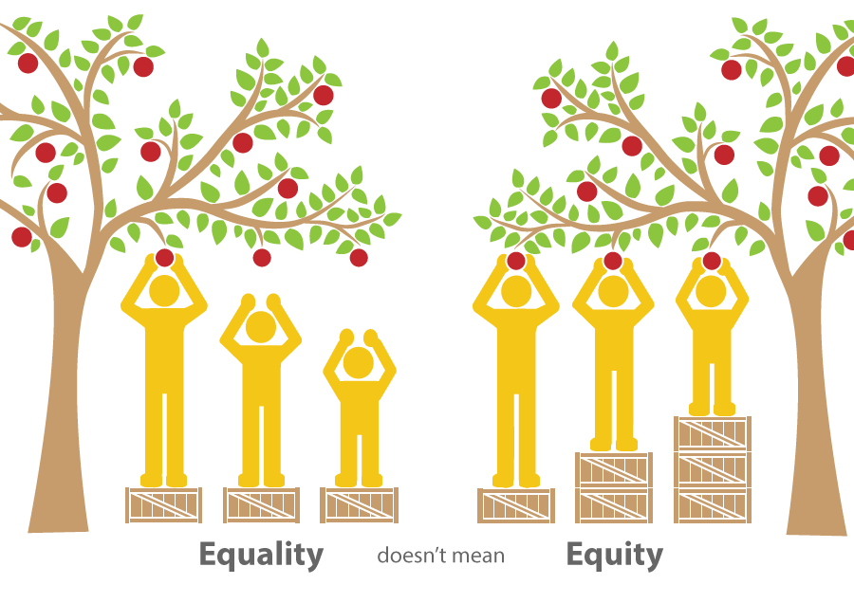
ONLINE EQUITY GOALS
Decrease success rate gaps in online courses
Identify strategies to address inequities
Notes:
Arnita
Broad-based Work Group (faculty, counselors, administrators, researchers, instructional designer)
Meets biweekly via Zoom
Focused on creating an equity framework to address achievement gaps, provide institutions with support to assist them with meeting the goals outlined in their student equity plans

Slide 8
Online Tutoring Capabilities
Students can
Meet with a live tutor (up to 24/7, depending on subject)
Use “Question and Answer Center” 24/7 (asynchronous tutoring)
Essay or paper review 24/7 via “Paper Center”
Service funded for pilot colleges; reduced cost for non-pilot colleges

Slide 9
Online Tutoring Platform
WorldWideWhiteboard
License for any CCC to use w/local tutors
Longer term goal is to develop a CCC online tutoring consortium built upon the WWWB platform

Slide 10
Extra Credit Assignment
Instructions:
Pick one problem from Chapter 1 that you are unsure about. Your question can be about a concept or a homework questions.
Click on NetTutor in our home course page.
Post your question and ask the live tutor for assistance. BE SPECIFIC.
Once you have received your assistance, send me an email.

Slide 11
5. Email instructions:
• xxx@yyyy.edu - my email address
• Math 100 - NetTutor - subject line
• Put the question that you submitted to the tutor in the email body.
• List two ways that the tutor helped you to understand the concept. Write in complete sentences.
• Due date: AA, BB pm
6. PS - I am able to review all tutoring sessions, if I want to, which I don't. However, do not "pretend" that you got tutoring help when you really did not. I will know.

Slide 12
Jessica
“The [tutor] was a huge help ... I will definitely be using this tutoring service often! Thank you for encouraging your students to use this resource.”

Slide 13
Anna
“Wow this program was great. Tutor was able to break down for me step by step what to do. They were able to ask me which method I wanted to use [for factoring].”

Slide 14
Wei
“First the tutor used a different method … to solve the problem. This was different from what I saw in the video. I found that this method made me see another way to solve the problem...,”

Slide 15
Reflection Question: What’s going well?
After students knew their Exam 1 score, four quiz scores and six to eight homework scores
Several students - using NetTutor whenever they got “stuck” was very helpful, as they could go online and get assistance when it fit their schedule and that the tutors were “nice.”

Slide 16
Reflection Question: What more can you do to help yourself succeed?
Several students - wrote that they would start using NetTutor since their classmates had posted that they liked the service.
End of term check: none of those students had used NetTutor or on-campus tutoring

Slide 17
Observations
Similar to on-campus tutoring, the students who really needed tutoring, did not use online tutoring.
The students who used the tutoring, were appreciative and felt that their competency increased.

Slide 18
More info:
http://ccconlineed.org/student-success-resources/tutoring/
or
http://ccconlineed.org

Slide 19
Questions
Thank you!
billowsky@CCCOnlineEd.org
@DrBSI

