Slide 1
Innovation & Online Tutoring: Strategic Choices
ACTLA, San Diego
April 2018

Slide 2
Session Objectives
Concrete examples of how various innovations (i.e. augmented reality, audio, video & group engagement tools) can be deployed within an online tutoring context
Framework for investigating how those technologies can influence student learning and engagement
Understanding how tools may have a distinctive impact on the phenomenon of online tutoring

Slide 3
Agenda
Practical overview of various technologies that can enhance online tutorials
Insights into theoretical underpinnings and principles that may help in choosing certain technologies
Suggested empirical framework for investigating the impact of such technology on student learning

Slide 4
Overview of Innovations
in Online Tutoring Contexts

Slide 5
When was your very first email?
Where were you?
What was it about?
When did you start using email for education-related purposes?
What was the first app you ever loaded on your phone?
What was the first app you used for education purposes?

Slide 6
Evolution of Online Tutoring Communication & Content Sharing
Early Days…
In the 90s
Synchronous
Asynchronous
Open University UK
Purdue’s OWL
First Online Tutoring

Slide 7
Current State: Dynamic, Multi-Level Exchange
Group tutoring
Video
Voice
Mobile applications
Screen, Photo, & Document sharing
Simultaneous use of multiple modalities using various tools

Slide 8
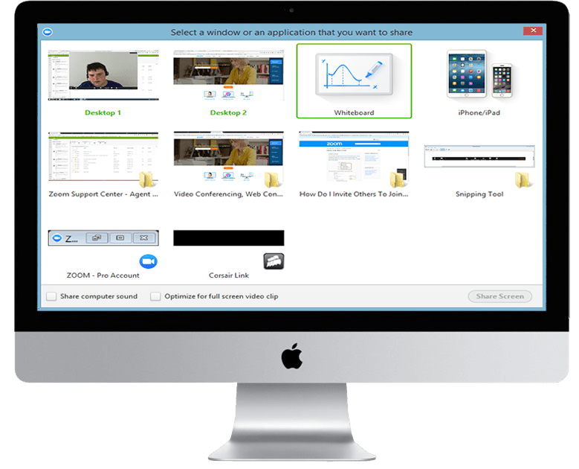
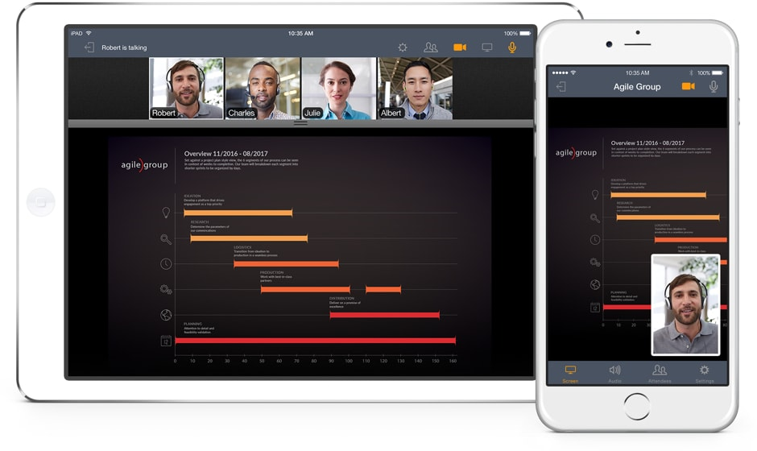
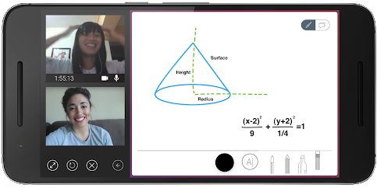

Slide 9
Rapid Advances & Possibilities
Artificial Intelligence
Virtual Reality
Augmented Reality
Mixed Reality
Possible Online tutoring or coaching scenarios

Slide 11
What technologies have you used for online tutoring?
What has your experience been with them?
How have students responded?
How do you choose which innovation(s) to use?

Slide 12
Principles & Practice

Slide 13
Research Basis
A large and growing knowledge regarding online learning more generally.
However, little theoretical or empirical research on the phenomenon of online tutoring.
Lots of anecdotal trial and error

Slide 14
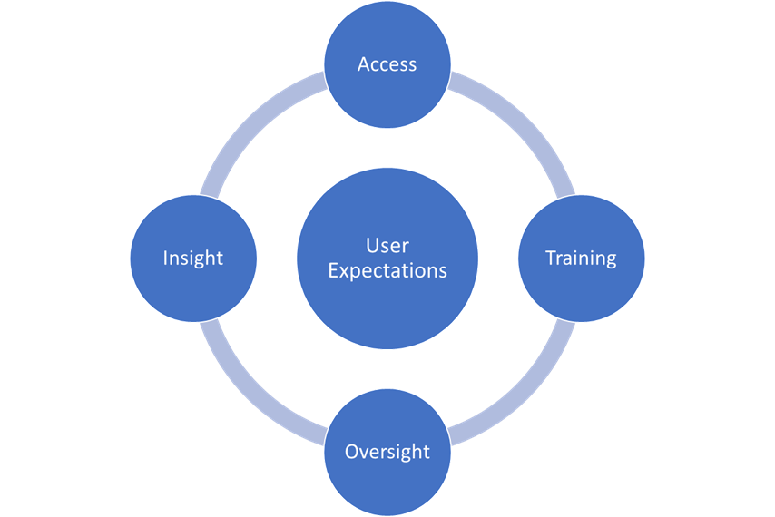
Principles to
Drive Practice
Ehmann, Tearnan, Bush (c) 2018

Slide 15
What factors most influence your own contexts?

Slide 16
Framework for Investigating Student Learning and Online Tutoring
Ehmann, Tearnan, Bush (c) 2018

Slide 17
Small Group Exploration
Identify a new technology you’d like to implement for online tutoring
What questions would you have about the technology & student learning?
What steps would you take to study the impact?
How would you want to analyze & share your findings?
Worksheet
Ehmann, Tearnan, Bush (c) 2018

Slide 18
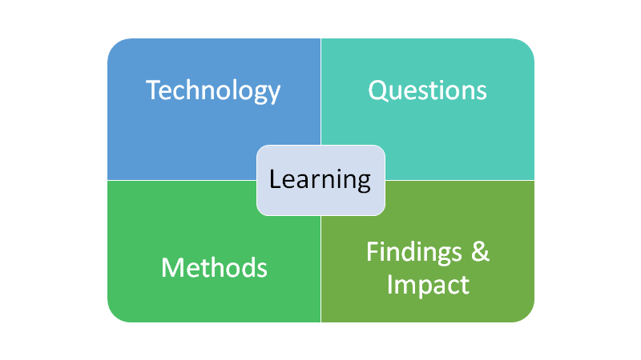
Framework
Ehmann, Tearnan, Bush (c) 2018

Slide 19
Thank you!
Linda Bush, PhD
STEM
linda.bush@pearson.com
Allyson Tearnan, PhD
Writing & Humanities
allyson.tearnan@pearson.com

