Slide 1
Building up Basic Math and English Skills Programs in Academic Support at Sierra Community College
Sarah Konst, Tutor Center Faculty, Sierra College, Rocklin Campus
Jennie Longmire, Tutor Center Coordinator, Sierra College, Rocklin Campus
Melody Meier, Learning Center Coordinator, Sierra College, Nevada County Campus

Slide 2
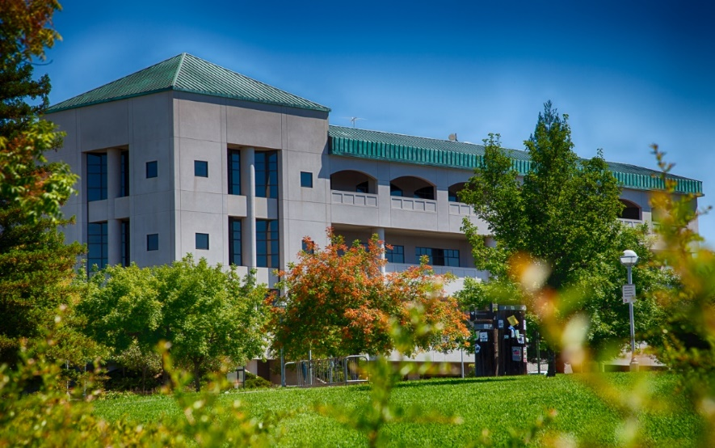
About our Tutor Centers
Rocklin Campus (14,000 students)
The Rocklin Tutor Center:
has around 100 tutors and embedded peers who tutor about 140 classes.
offers drop-in tutoring, appointment tutoring, and has PASS peer embedded tutors in 80 classes.
had 8000 hours of usage in the fall 2018 semester.
Nevada County Campus (1,500 students)
The NCC Learning Center:
offers drop-in tutoring across the disciplines with around 35 tutors.
has 22 PASS peer embedded tutors in 30 classes.
had over 7000 hours of usage in the fall 2018 semester.

Slide 3
Current Preparations for Fall 2019
At Rocklin:
training peer tutors to take one on one appointments in:
study skills (trained by Tutor Center faculty),
math study skills (trained and supported by a math/Tutor Center faculty),
writing study skills (trained and supported by an on loan English faculty).
incorporating reading strategies into the required one unit Tutor Training class.
letting counselors know the Tutor Center can help struggling students with math, English, and study skills support.
placing embedded peer tutors in many Math and English 1A support classes in Fall.
At NCC:
We endeavor to replicate Rocklin training programs.
We have 15 hours/week of faculty math support.
We have 24 hours of Writing Center IA support in the Learning Center.
As a satellite campus we communicate with faculty, counseling, and staff to create a strong support structure for students.
PASS peers will be embedded in as many math and English 1A classes as possible.

Slide 4
Basic Math Skills AB 705
What do CA colleges need to do?
Every college is required to maximize the probability that a student will enter and complete transfer-level coursework in English and math within one year and use high school coursework, grades, and/or grade point average for placement into Math and English.
All community colleges are required to be in compliance no later than fall of 2019
The biggest impacts to Math
The elimination of Skill Development Math classes
Reduction in the number of Introductory and Intermediate math classes

Slide 5
Basic Math Skills AB 705
What we see happening

Slide 6
Basic Math Skills A little History
Previous Courses Available
581 – Arithmetic Review – 4 credits
Apply order of operations, solve applied problems, utilize exponential notation, and present reasoning for mathematical solutions using whole numbers, fractions, decimals, proportions, and percents.
582 – Pre- Algebra – 4 credits
581 material review and applications with more complex problems, graph and solve linear equations, applied problems with two variables.
585 – Foundations of Mathematics – 6 credits
Apply the concept of numeracy, think critically, and use proportional reasoning to interpret and solve problems involving variables. Develop fluency in mathematics communication, specific learning strategies, and study techniques. Problems are from a variety of contexts including historical perspectives.

Slide 7
Basic Math Skills After AB 705
New Entry Level & Support Courses
Math E – Practical Mathematics – 6 credits
A practical math class for non-math majors. Problems are from a variety of contexts utilizing mathematical solutions and the application of technology. Develop fluency in mathematics communication and explore specific learning strategies and study techniques.
Math G – B-STEM Intermediate Algebra - 5 credits
Topics are geared towards B-STEM majors. Develop the ability to think critically and solve problems in a variety of contexts using the tools of mathematics and technology. Develop specific learning strategies, study techniques, and a fluency in mathematical communication.
Math G – B-STEM with support - 8 credits
Math 13 – Elementary Statistics – 4 credits
Math 13 with support – 6 credits
2 credits plus 4 credit parent course
Future split option for 3 credits each
Math 12 – College Algebra – 4 credits
Math 12 with Support – 6 credits
2 credits plus 4 credit parent course
Limited Availability
Math A – Introductory Algebra – 4 or 5 credits
Math D – Intermediate Algebra – 4 or 5 credits

Slide 8
Basic Math Skills Student Lens
Wait a minute!
What about the students in the other percentages?
Who are they and what do they need?
How can we help these students?

Slide 9
Basic Math Skills Student Lens
Quotes from students who were asked how they would feel if they had to start at the new entry level math…
“My stress level would be through the roof”
“That would be an absolute nightmare”
“I can’t imagine”
“I would fail”
“I might not even try (a higher level class) because the bar is too high”

Slide 10
Basic Math Skills Student Lens
Low Performing Student
Low Performers
This student started their math track by taking Skill Development 581, the lowest level available even though their placement at the time indicated they could start in 582.
They explained that they weren’t serious in high school and performed low in math. They thought that going back to basics would help and it did.
This student subsequently earned their Associates degree and has a full time professional career. They are also currently pursuing a bachelors degree.
Requisites
Need depth and breadth
Tend to need more time
Confidence building
Metacognition skills

Slide 11
Basic Math Skills Student Lens
Returning Student
Returners
Having been out of school for several years before attending Community College, this student started their math track in Skill Development 581, the lowest level available.
When asked how they would feel if they started community college today with the higher entry level math classes, they emphatically said “I would fail”.
This student subsequently earned their college degree and now has a full time career in their chosen field of study.
Requisites
Overall basic math review
Identify areas that need more in-depth skills build-up
Confidence building
Metacognition skills

Slide 12
Basic Math Skills Student Lens
ESL Students
ESL Students
ESL students often take math classes in a lower level than their math capabilities indicate.
These students may need math vocabulary help. They also might need math verbal, writing, and reading skills before taking a higher level math class.
Forcing them into a class without these skills could result in a math grade below their actual capabilities.
Requisites
Build up mathematics vocabulary
Competence in reading and writing in Math
Verbal and auditory math comprehension

Slide 13
Ways we plan to support those who need help with basic math skills
Wait a minute!
We really do need some basic skills curriculum available for our students.
We need to get something in place quickly so our students feel supported and not stressed out.
How would a program to help with basic skills be organized?

Slide 14
Basic Math Skills Review Requisites
Student Requisites
Related Competencies
Returners –
Overall brush-up on basic math
Specific skills build-up
Low performers –
Need depth and breadth
Tend to need more time
ESL –
Build up mathematics vocabulary
Competence in reading and writing in Math
Verbal and auditory math comprehension
Metacognition skills
Math anxiety strategies
Test & note taking skills
Classroom time management
Homework and study optimization
Confidence

Slide 15
Basic Math Skills The Dream Program
Create a basic math skills program that has the following characteristics:
Compliant with the new laws
Open entry and exit
Student driven curriculum
Math skills diagnostics component
Includes metacognition skills
Built-in material review
Delivered to small groups and individuals
Run by peer tutors
Topics can be in depth or quick review
Just-in-time skills onboarding
21st century skills compatible
Various delivery methods
Peer tutor led instruction
Offered to both on-ground and online students
Completely free to students

Slide 16
Ways we plan to support those who need help with basic math skills
Wait a minute!
Is it possible to handle such varying types of pedagogical needs?
How can you provide enough customization to get students exactly what they need?
How can student services support a curriculum that isn’t linked to a class?

Slide 17
Basic Math Skills Conceptual Solution
1. Develop basic math skills curriculum residing outside of the regular classroom
2. Identify students who might benefit from basic math skills
3. Enroll students into the basic math skills curriculum
4. Students complete the curriculum and are ready to tackle their mathematics goals

Slide 18
Basic Math Skills 1. Develop basic math skills curriculum residing outside of the regular classroom
Individualized Approach
Student Driven Curriculum
Intake appointment to establish student goals related to math, understand their curriculum delivery preferences, and gauge metacognition skills
Diagnostic skills test
Student Success Plan based on their goals and skills test results
Peer tutor involvement in curriculum development
Student binders with their Success Plan and materials
One-on-one tutoring appointments
General drop in hours
Opportunity for regular review
Dive deep or cover ground
Continuum along the student’s success plan

Slide 19
Basic Math Skills 2. Identify students who might benefit from basic math skills
Wide-Ranging Search
Counseling
Mathematics Department
Starfish
Interest Area Support Specialists
Direct marketing (flyers, tabling, emails)
PASS Peers
Professors
Other referrals

Slide 20
Basic Math Skills 3. Enroll students into the basic math skills curriculum
New Category
Math Study Skills as a topic for tutoring
Can enroll without being tagged to a class

Slide 21
Basic Math Skills 4. Students complete the curriculum and are ready to sign up for their entry level math class
Success Plan
Looking Back
Curriculum is identified from the student’s success plan
The Success plan may change as the student works on their skills
The completion point and next steps are determined by the student
Evaluate the program
Data available

Slide 22
Ways we plan to support those who need help with basic math skills
Wait a minute!
That sounds promising!
What about onboarding some of those math topics during summer?
Where does metacognition fit in?

Slide 23
Ways we plan to support those who need help with basic math skills

Slide 24
Plans for Helping Tutees with Basic Reading, and Writing Across the Curriculum Skills
An English faculty, Lisa Rochford, with faculty input, created modules for a developmental English class. As the class is discontinued, she is making those modules available to all academic support programs. The modules are free to students, and can be accessed online, or given out as printed packets. The modules cover topics such as sentences structure, punctuation, grammar, and annotation.
Lisa will spend time in the Tutor Center in the fall. She will train some peer tutors on the modules. Those peers will be available for appointments and maybe some drop-in sessions to help students working on modules.
Tutors embedded in the 2 unit support course attached to English 1A will be available in the Tutor Center to English 1A students in all classes.

Slide 25
Questions about our
program plans?

Slide 26
Choose a group and discuss. (We’ll discuss about 10 minutes, and then share together. Please choose a note taker.)
Supporting basic skills math in academic support programs
Supporting basic skills reading/writing in academic support programs
Using embedded peers in English and math support classes

Slide 27
Group Share
What are the highlights of the discussion you had with your group?

Slide 28
Next Steps?

