Slide 1
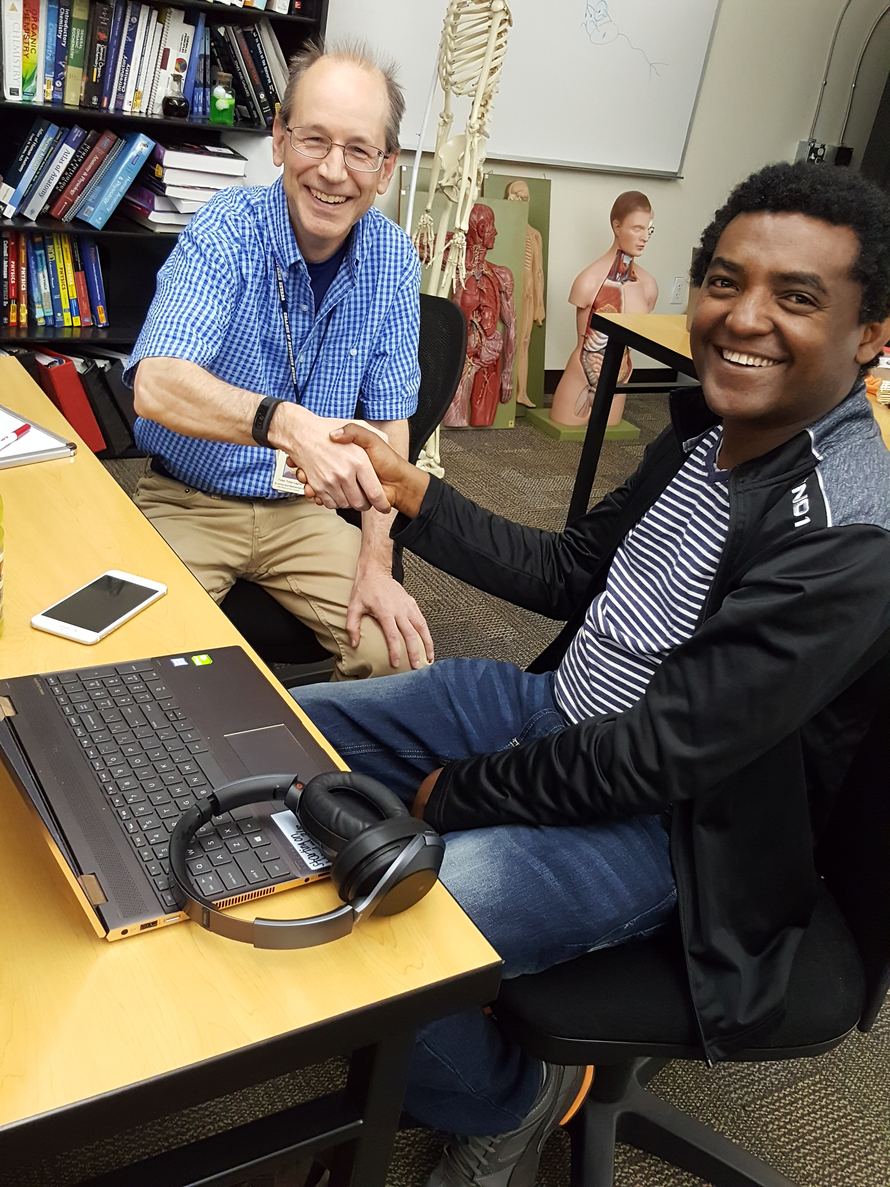
What Happens
Outside the
Classroom?
Dr. Peter Legner
College of Southern Nevada, Las Vegas, Nevada
peter.legner@csn.edu

Slide 2
About College of Southern Nevada
Founded 1971
3 Main Campuses & 7 Satellite Campuses
Largest Higher Ed Institution in Nevada
Fall 2019 total headcount = 33,161
Minority Serving Institution & Hispanic Serving Institution
11 meta-majors (career pathways)

Slide 4
When you think of students learning outside the classroom
Does it look like this?

Slide 5
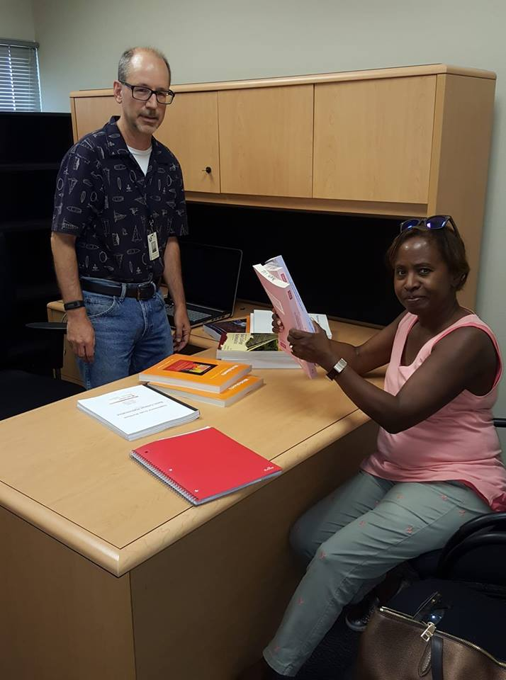

Slide 6
Or this?

Slide 7
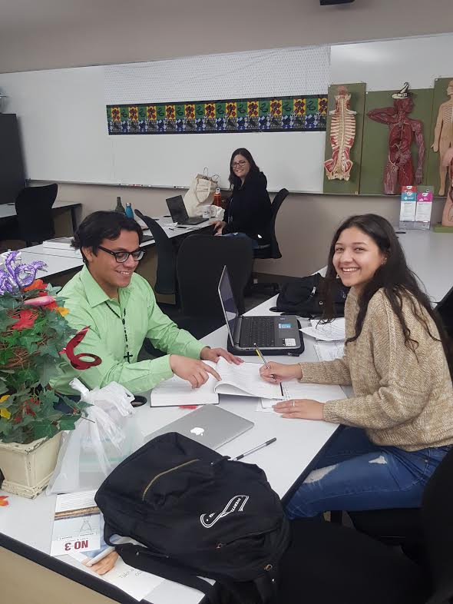

Slide 8
Instructors say, ‘please come see me in my office hours’ but every action they take says, ‘please do not come see me in my office hours.’
When I see a student in my office, I think I am being welcoming and friendly but meeting a student with me sitting behind a large desk, on my turf, with all my books and credentials on display may not communicate warmth and friendliness in the way I think it does. (Bloom)

Slide 9
Seven Learning Principles
-from How Learning Works, by Susan Ambrose, et.al.
-Students prior knowledge can help or hinder learning
-How students organize knowledge influences how they learn and apply what they know
-Students’ motivation determines, directs, and sustains what they do to learn
-To develop mastery, students must acquire component skills, practice integrating them, and know when to apply what they have learned
-Goal-directed practice coupled with targeted feedback enhances the quality of students’ learning
-Students’ current level of development interacts with the social, emotional, and intellectual climate of the course to impact learning
-To become self-directed learners, students must learn to monitor and adjust their approaches to learning (4ff)

Slide 10
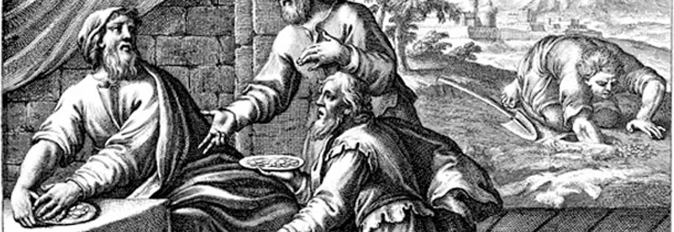
The Parable of the Talents

Slide 11
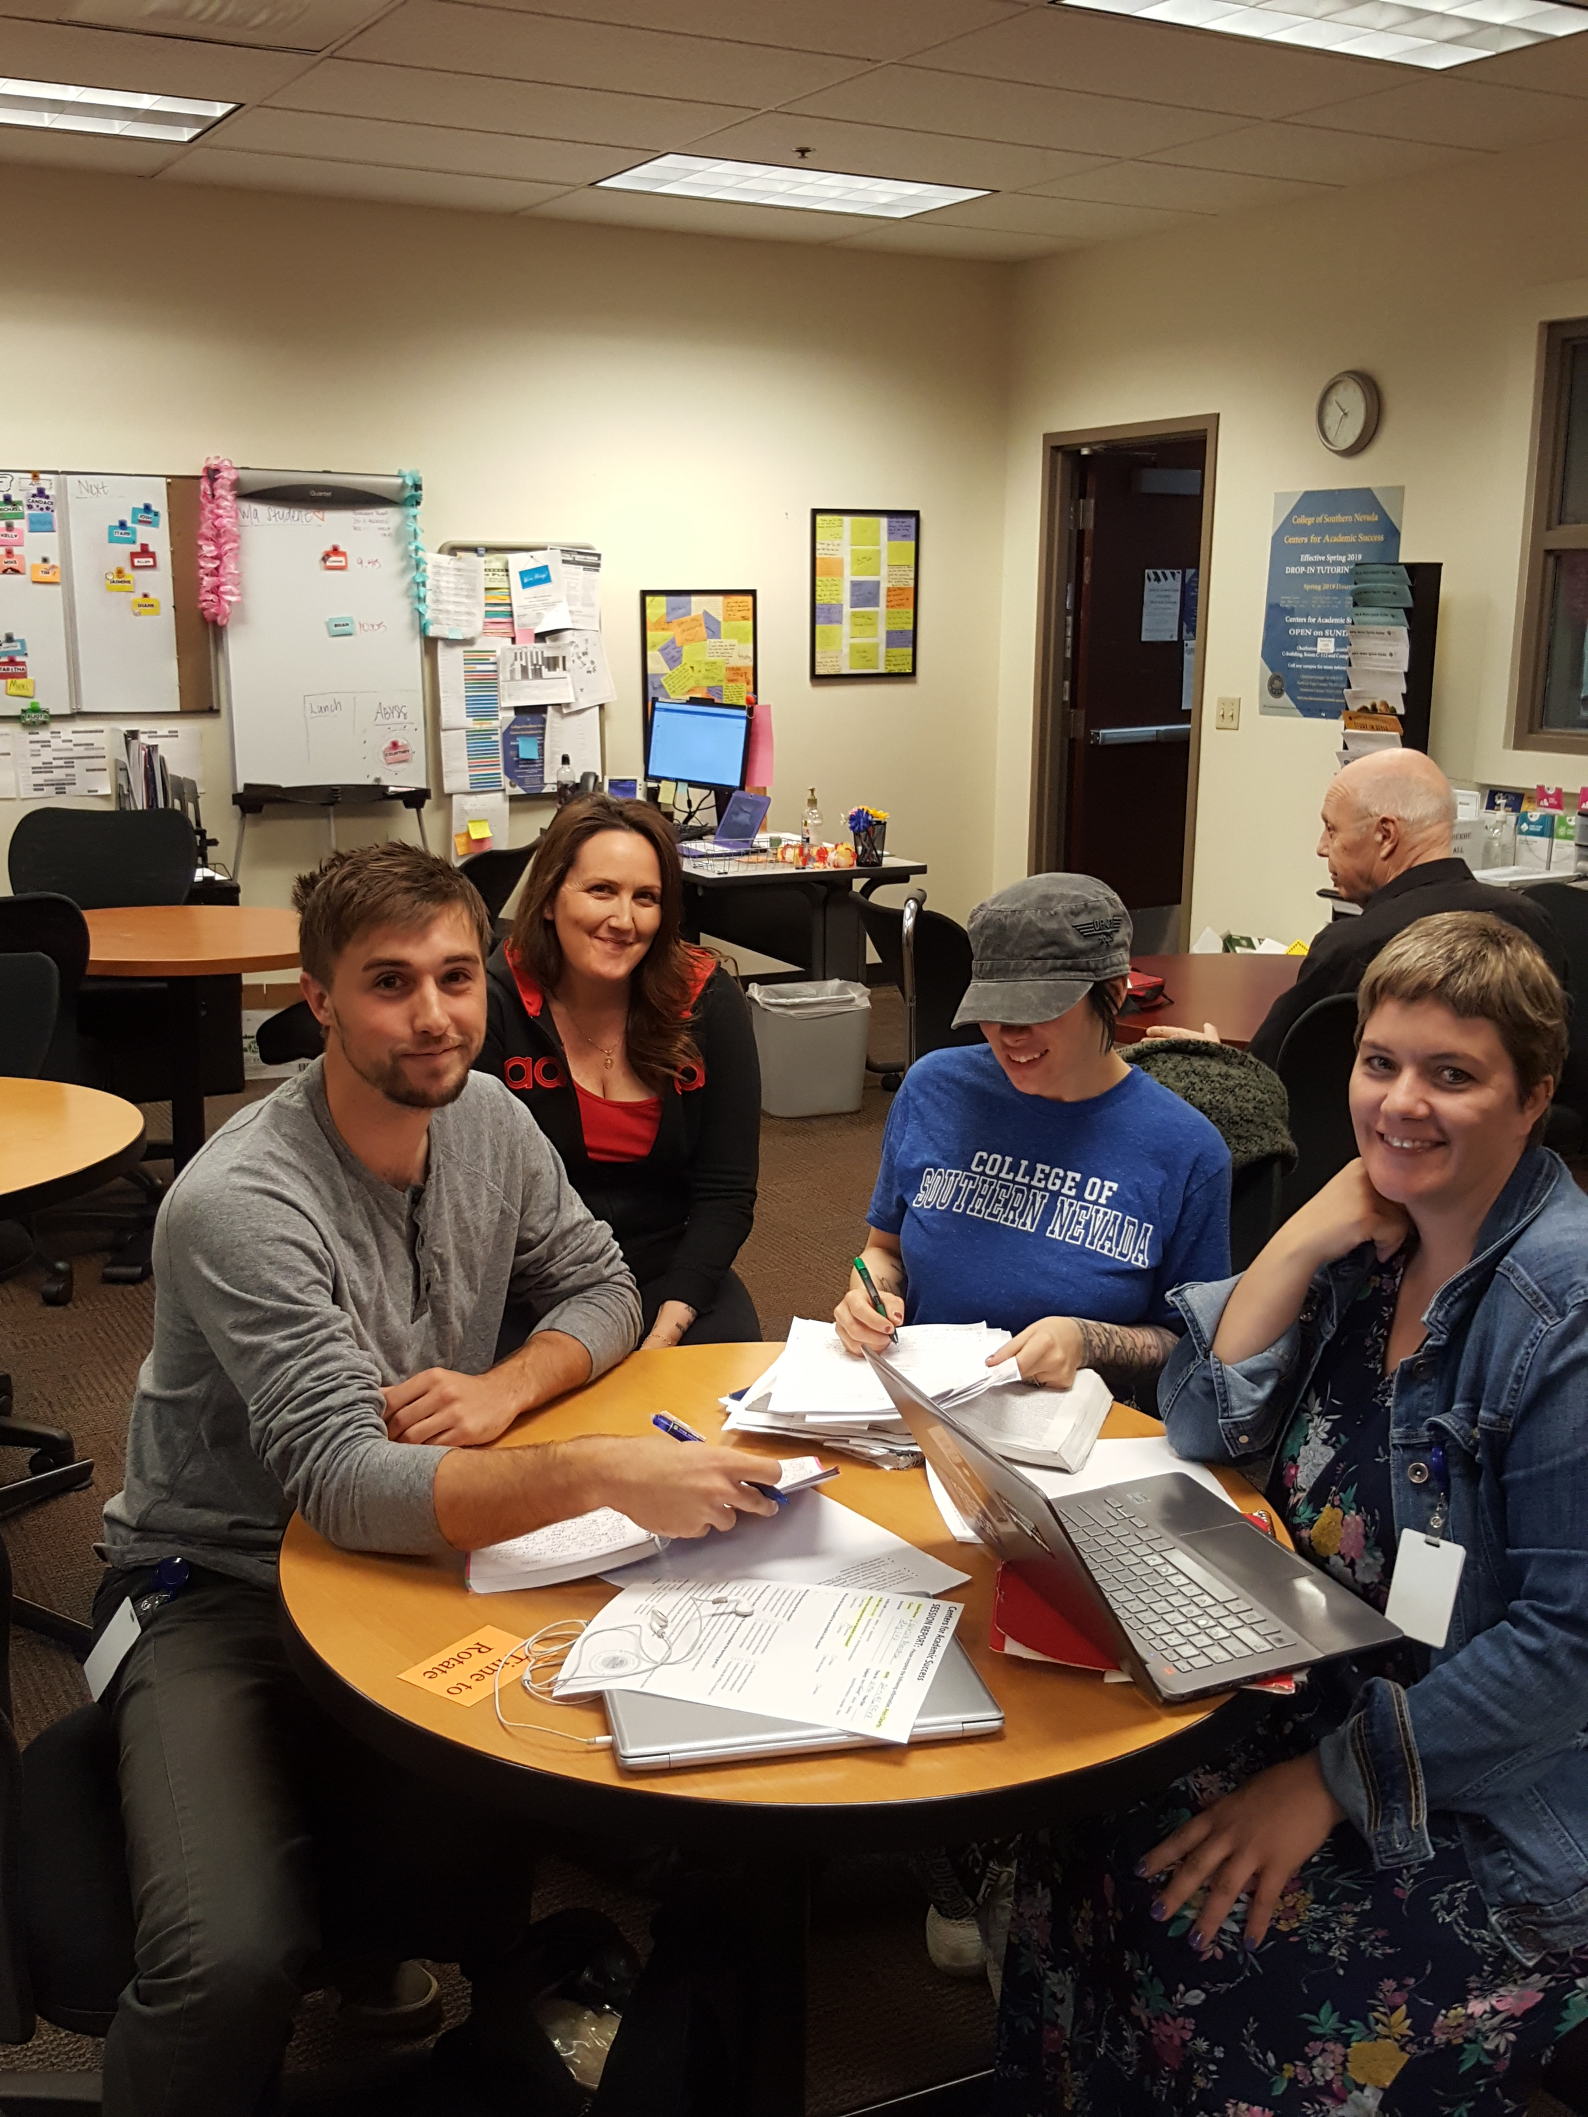
-Understand what the student wants
#1 correlation

Slide 12
-Understand what the student needs

Slide 13
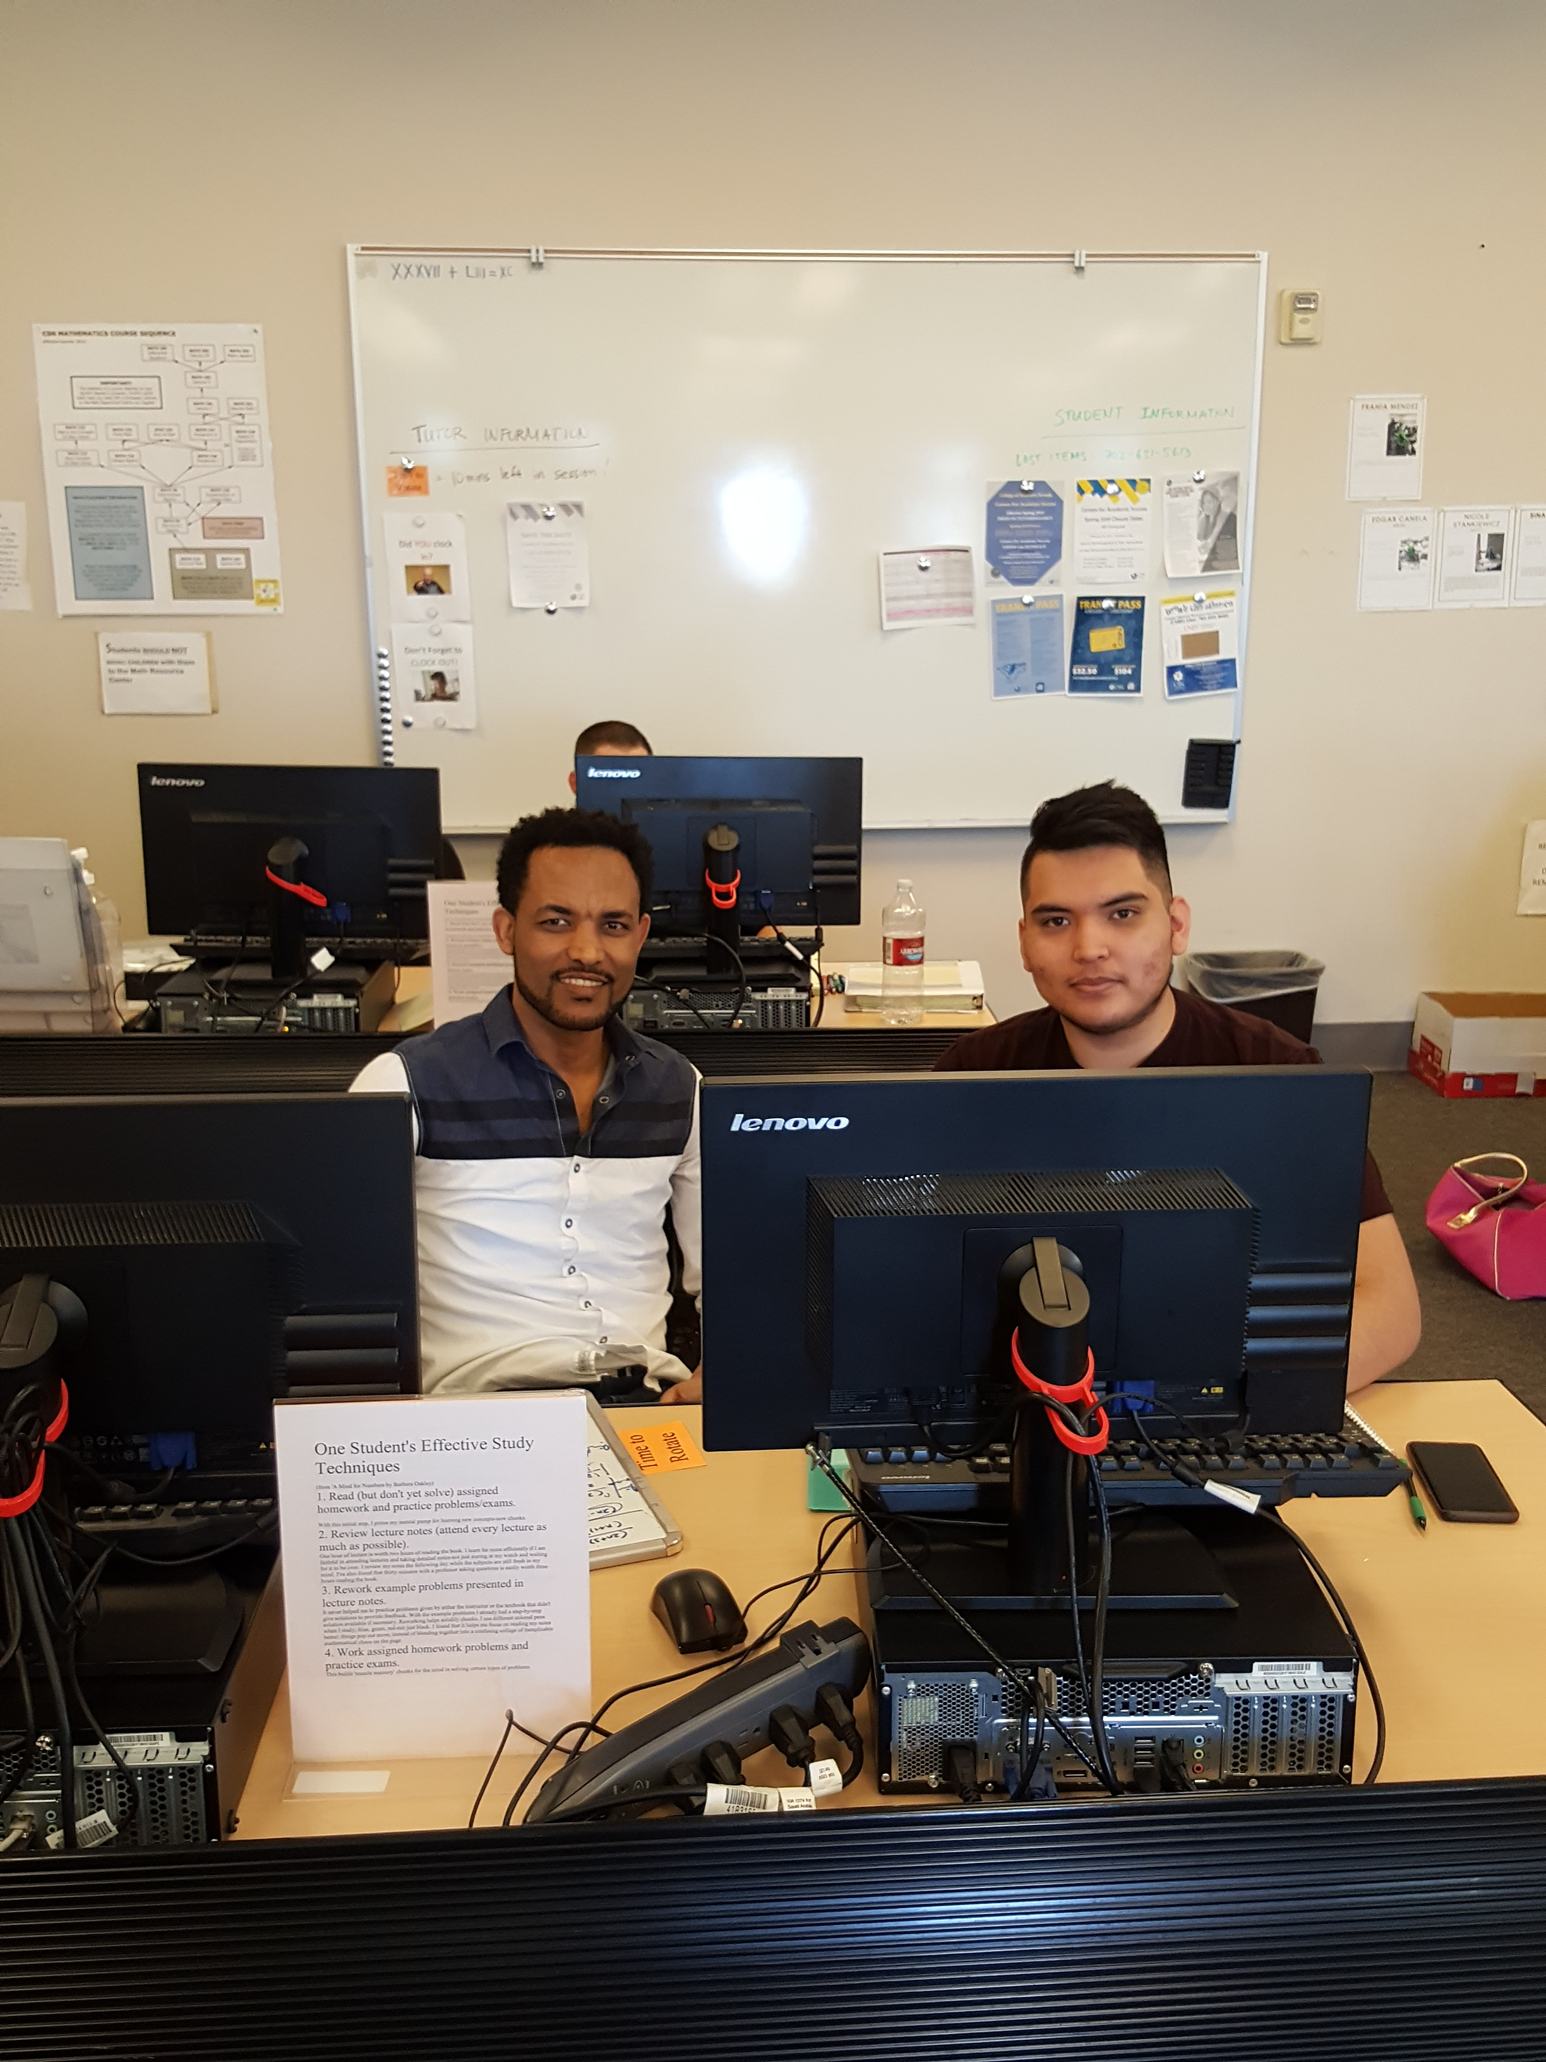
-Establishing an appropriate relationship is critical and difficult to do
Colvin, Chi
Poker chips

Slide 14
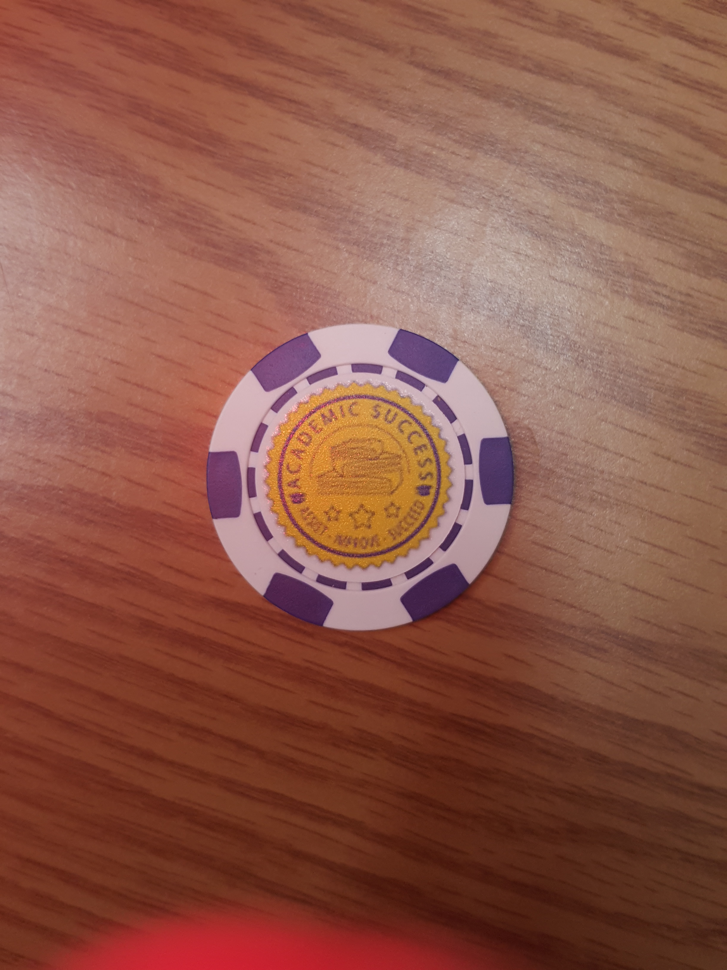

Slide 15
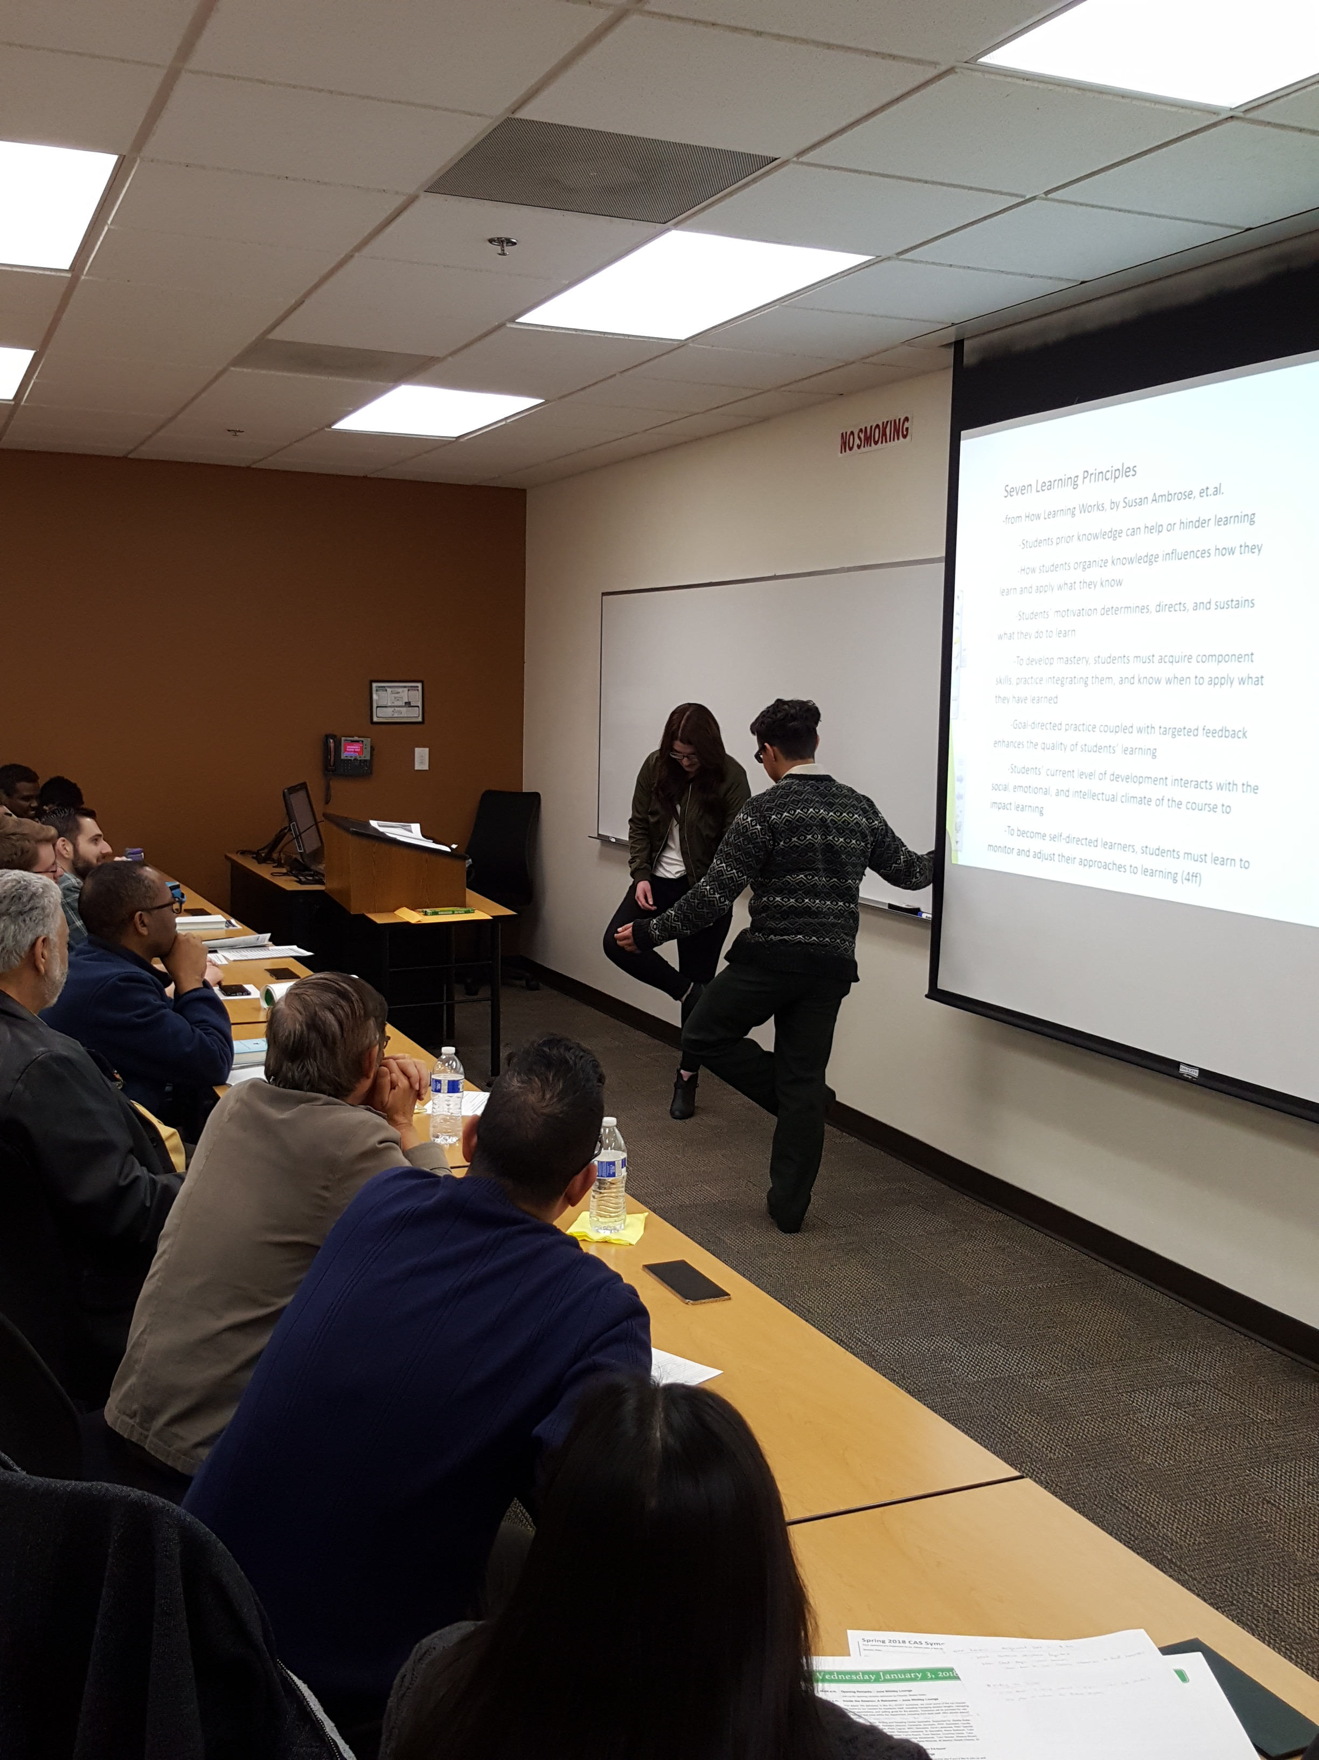
Lecture and Teaching Demonstration:
Let’s Learn to Jump Over Our Foot

Slide 16
Tutor Time Spent Speaking
 | Tutor Speaking (%) | Someone Speaking (Tallies)
Amount | 61.3 | 53.0
Standard Deviation | 14.3 | 10.7

Slide 17
Tutor Time Spent Writing
 | Tutor Writing (%) | Someone Writing (Tallies)
Amount | 47.0 | 35.2
Standard Deviation | 25.1 | 14.5

Slide 18
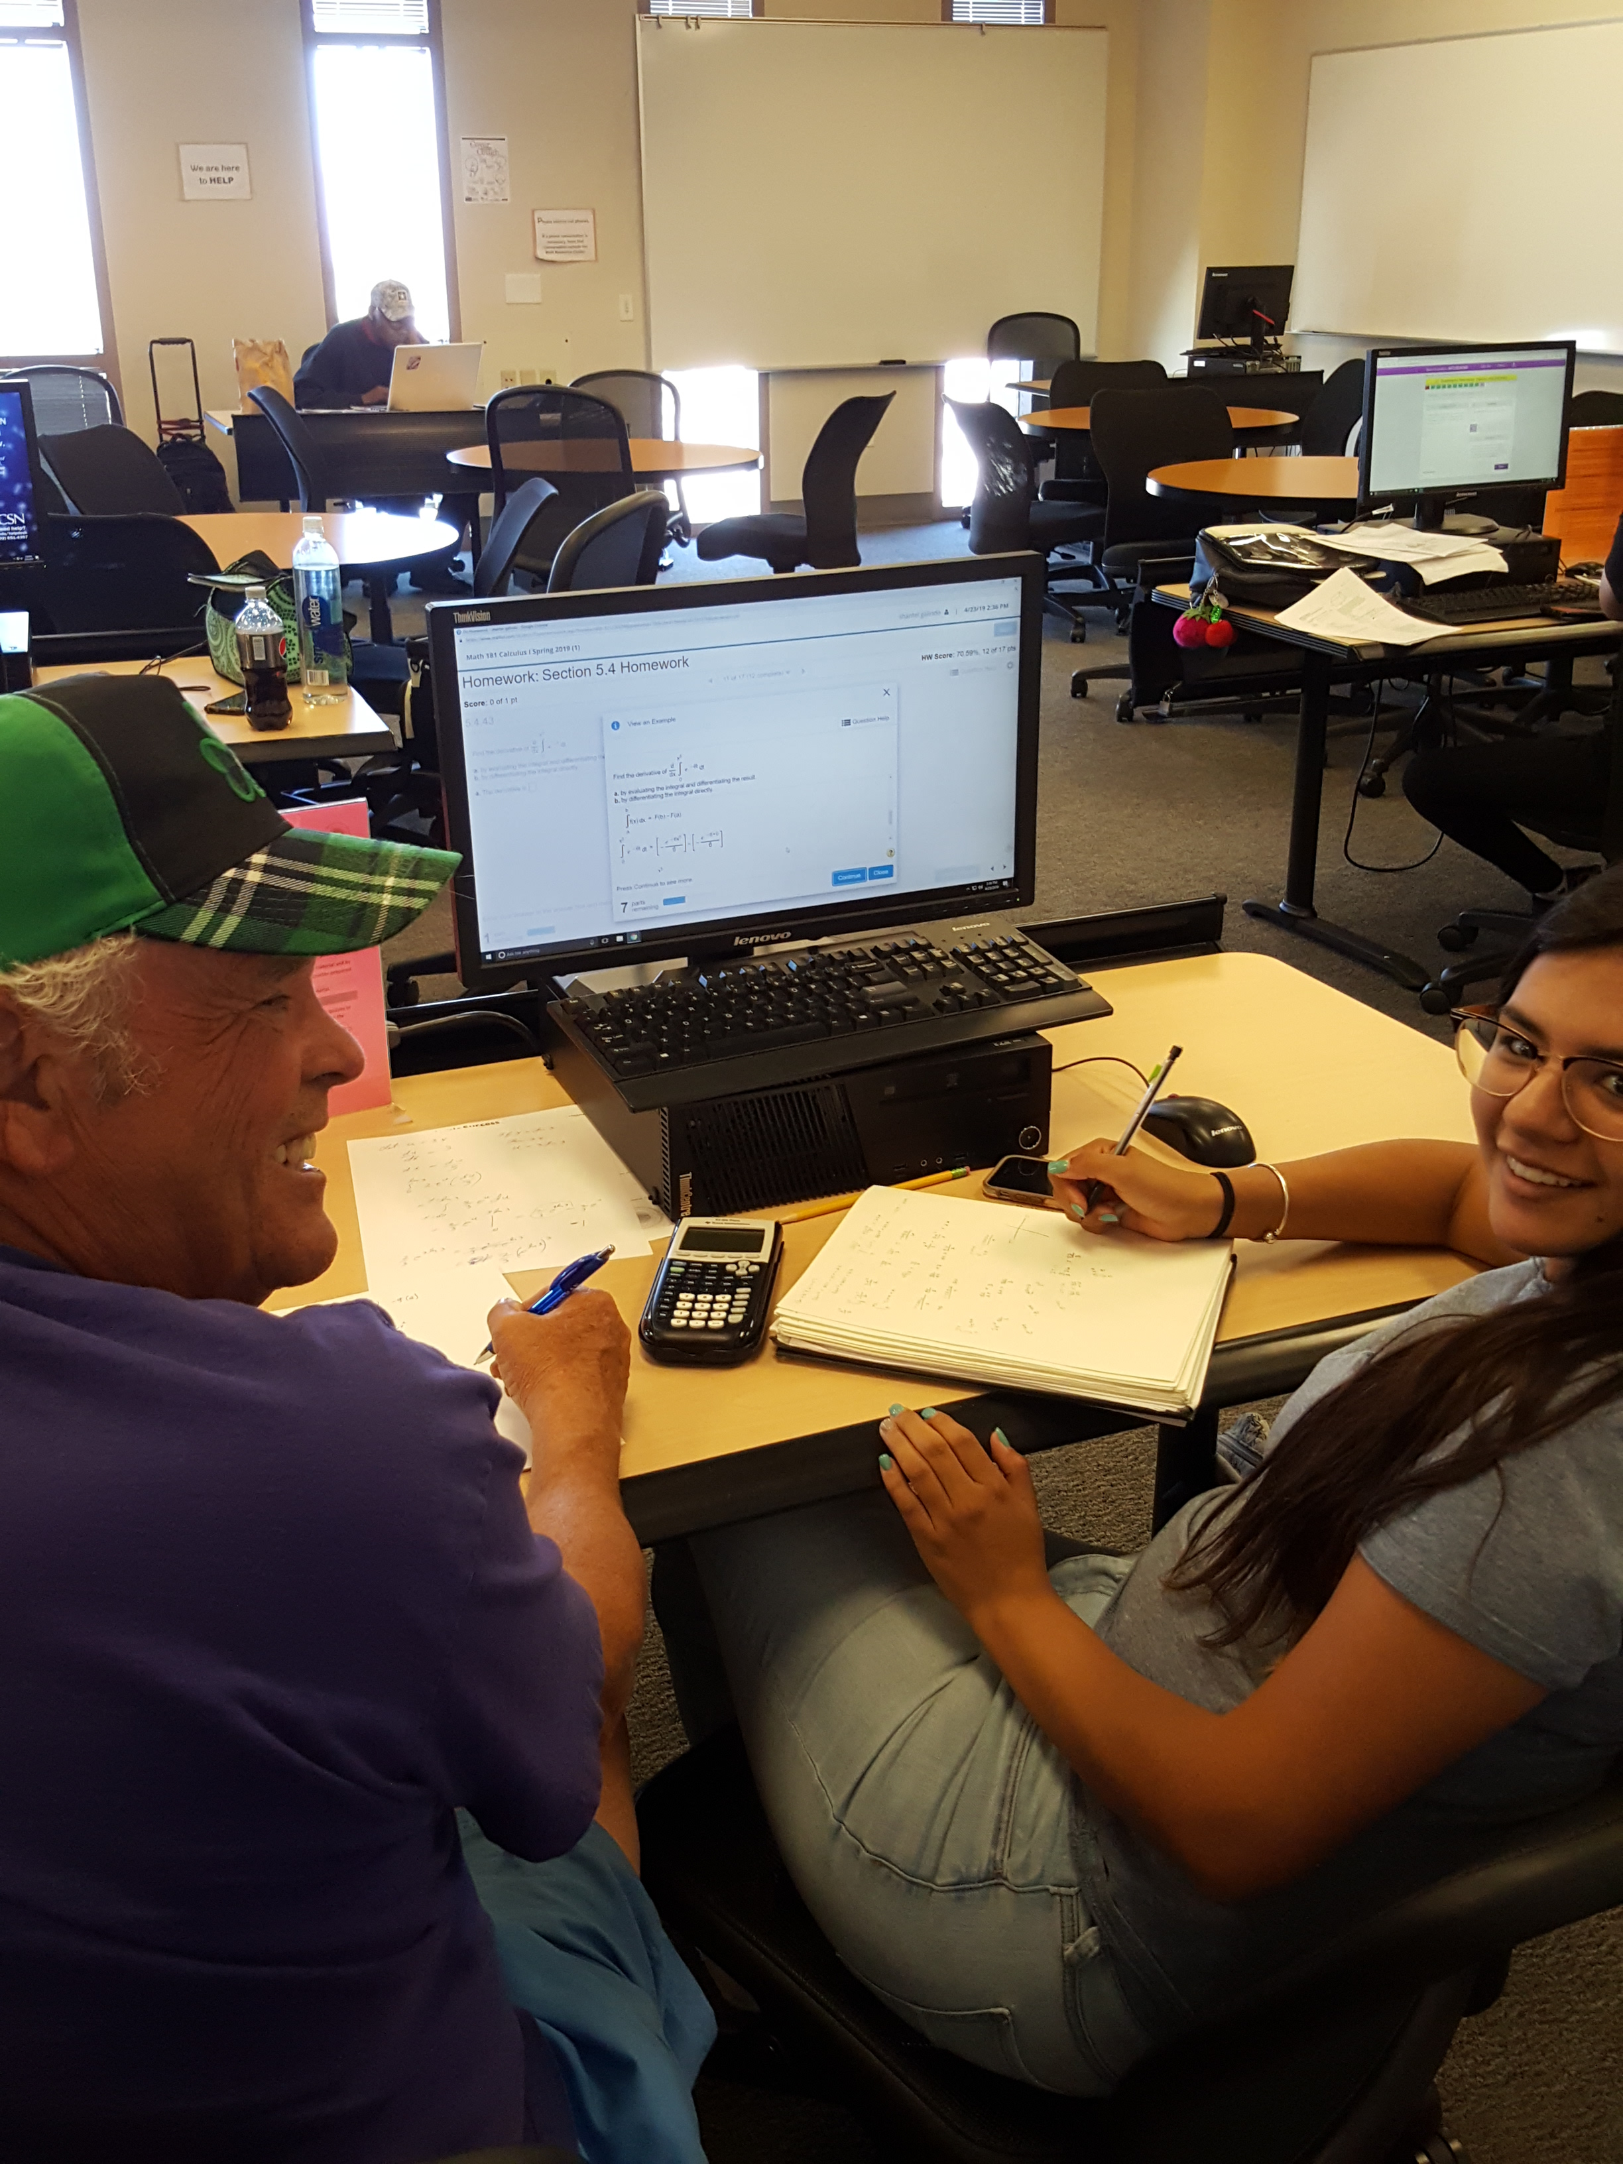
Instructors
Prepare students to work outside of class!!!

Slide 19
Push the Student to Learn and be a disciplined student
Give Advice on Studying
Stay Focused on One Subject
Challenge them to take good notes, attend class, ask questions in class
(Oakley)

Slide 20
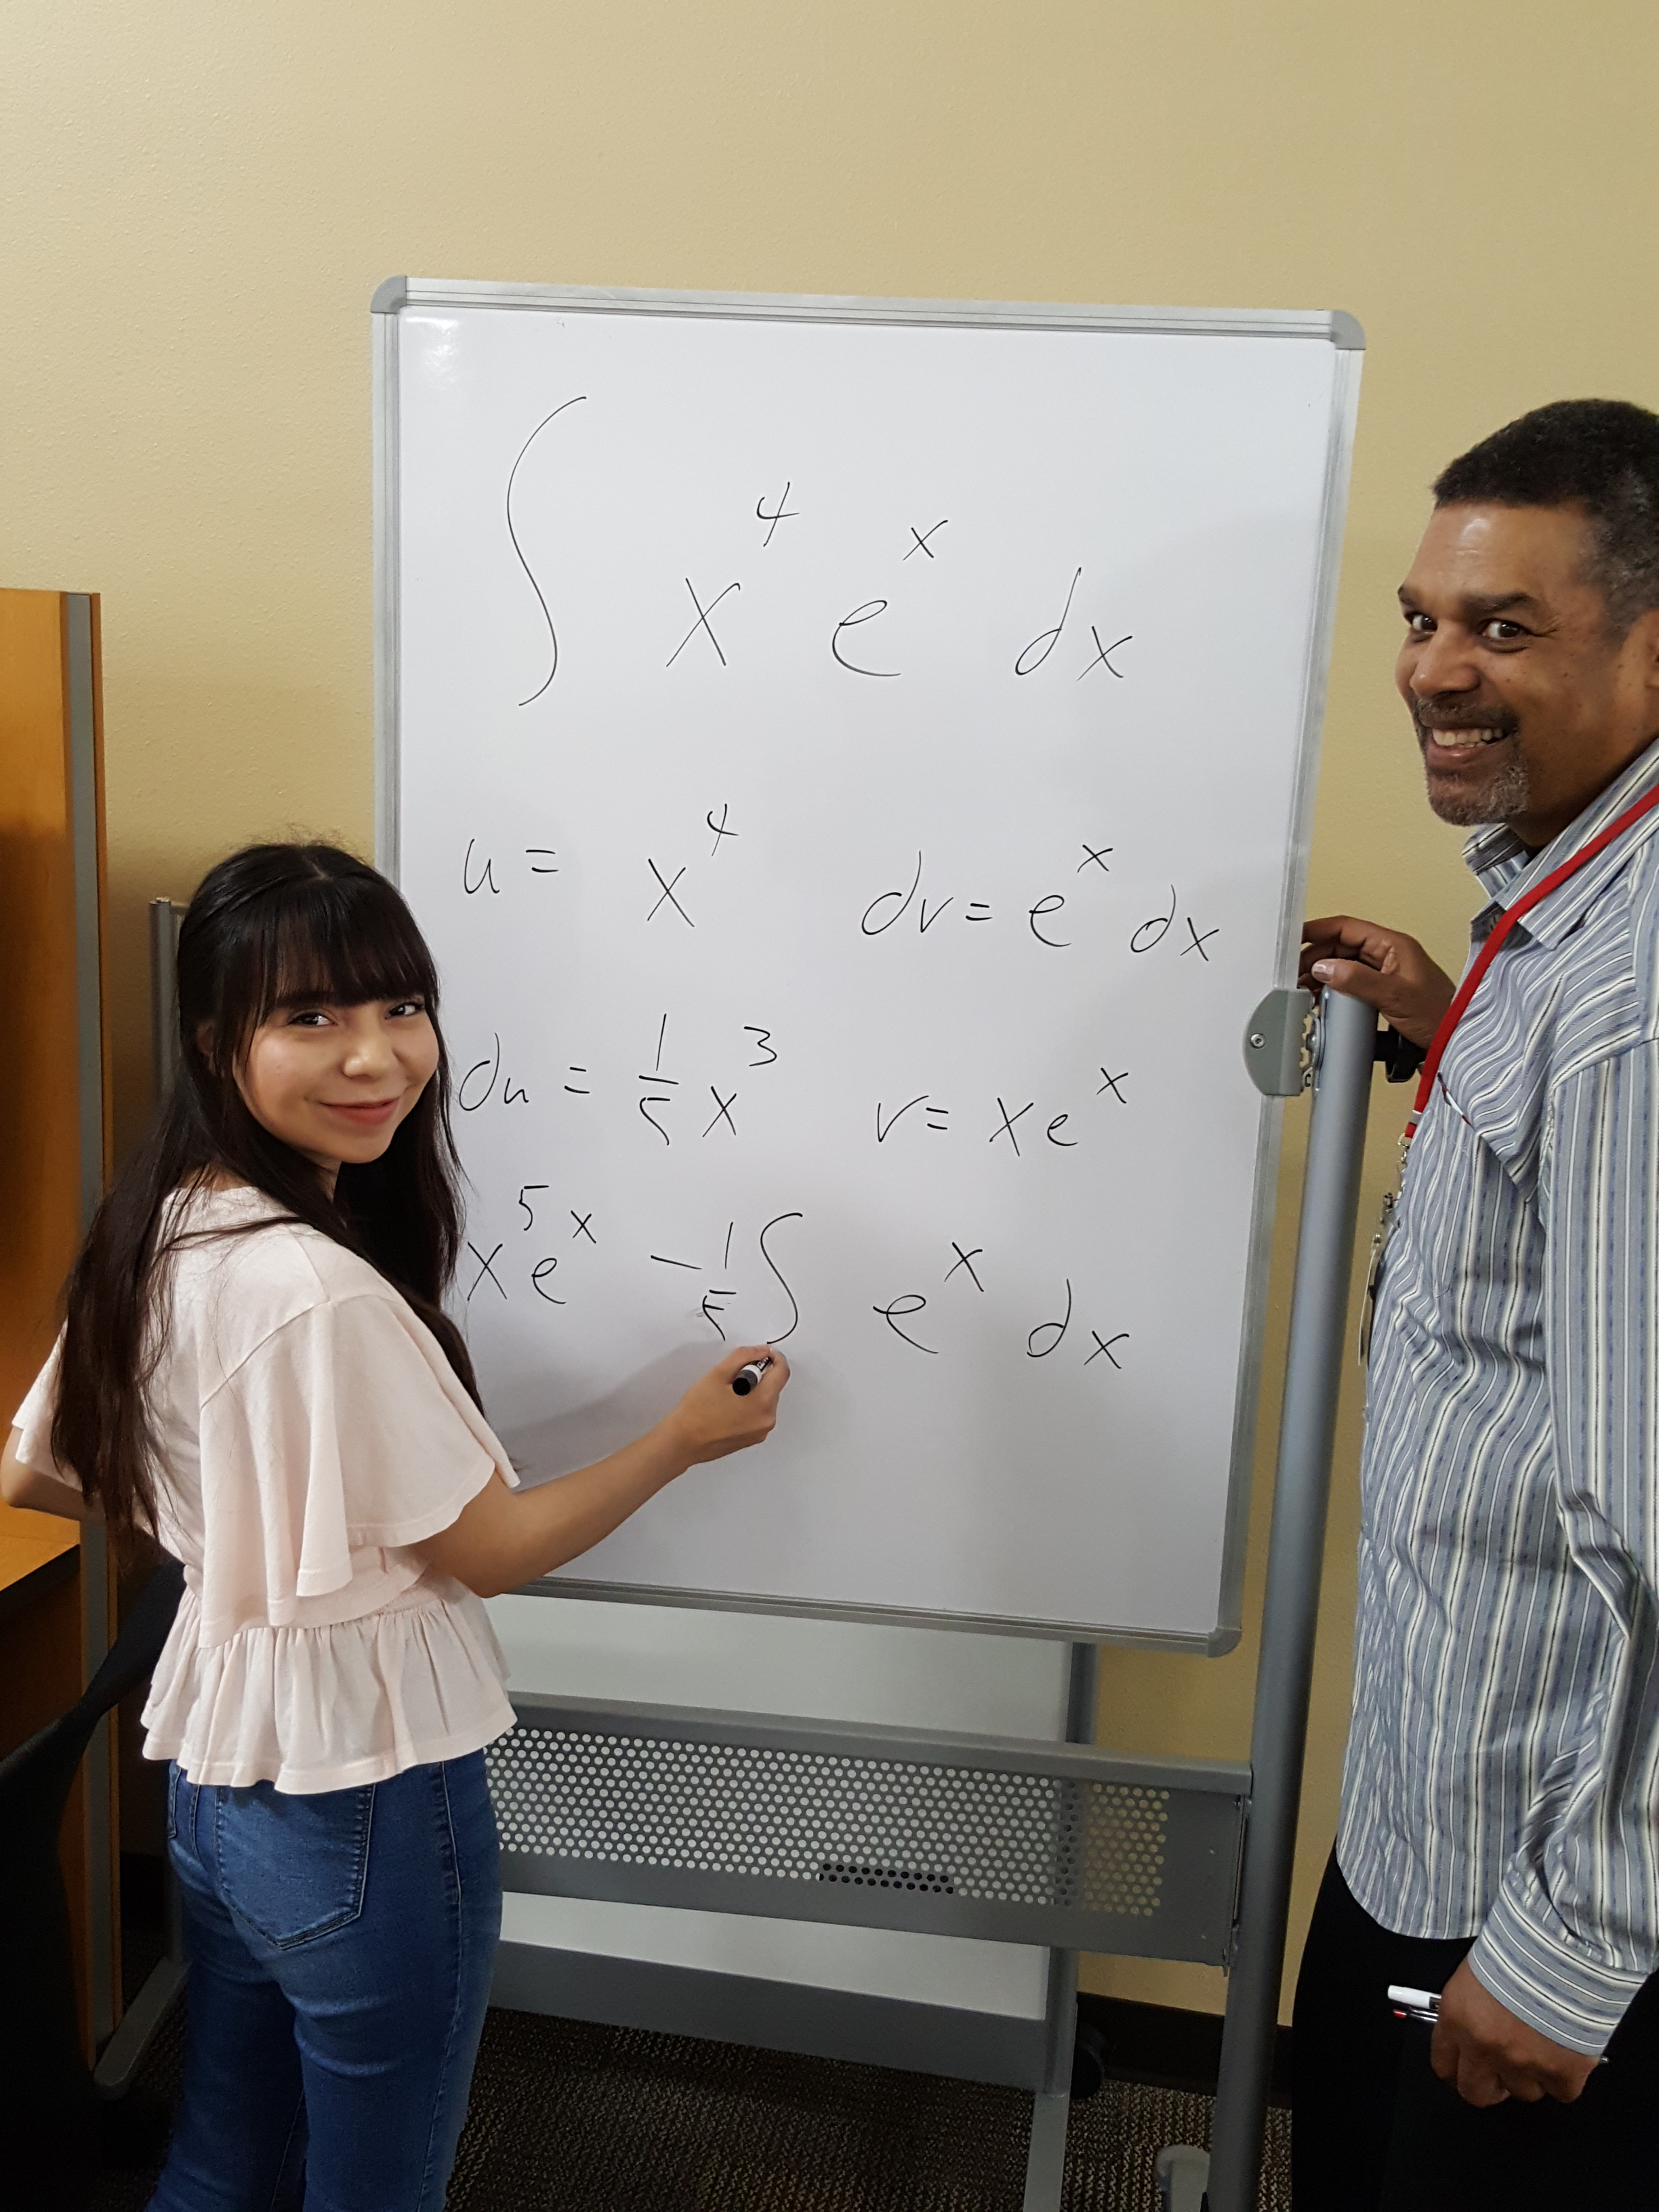
-The priority moves from the tutor to the student
(don’t bury any student in the sand)

Slide 21
Hulbert, Ann, “How to Escape the Community-College Trap,” The Atlantic, Jan-Feb 2014.

Slide 22
Suggested Takeaways:
-Read!
(Ambrose, Bloom, Oakley)
-Focus on Student Responsibility (in every session!)
-Build a Positive Climate (in every session!)
-Teach Study Skills, model effective learning, encourage class involvement

Slide 23
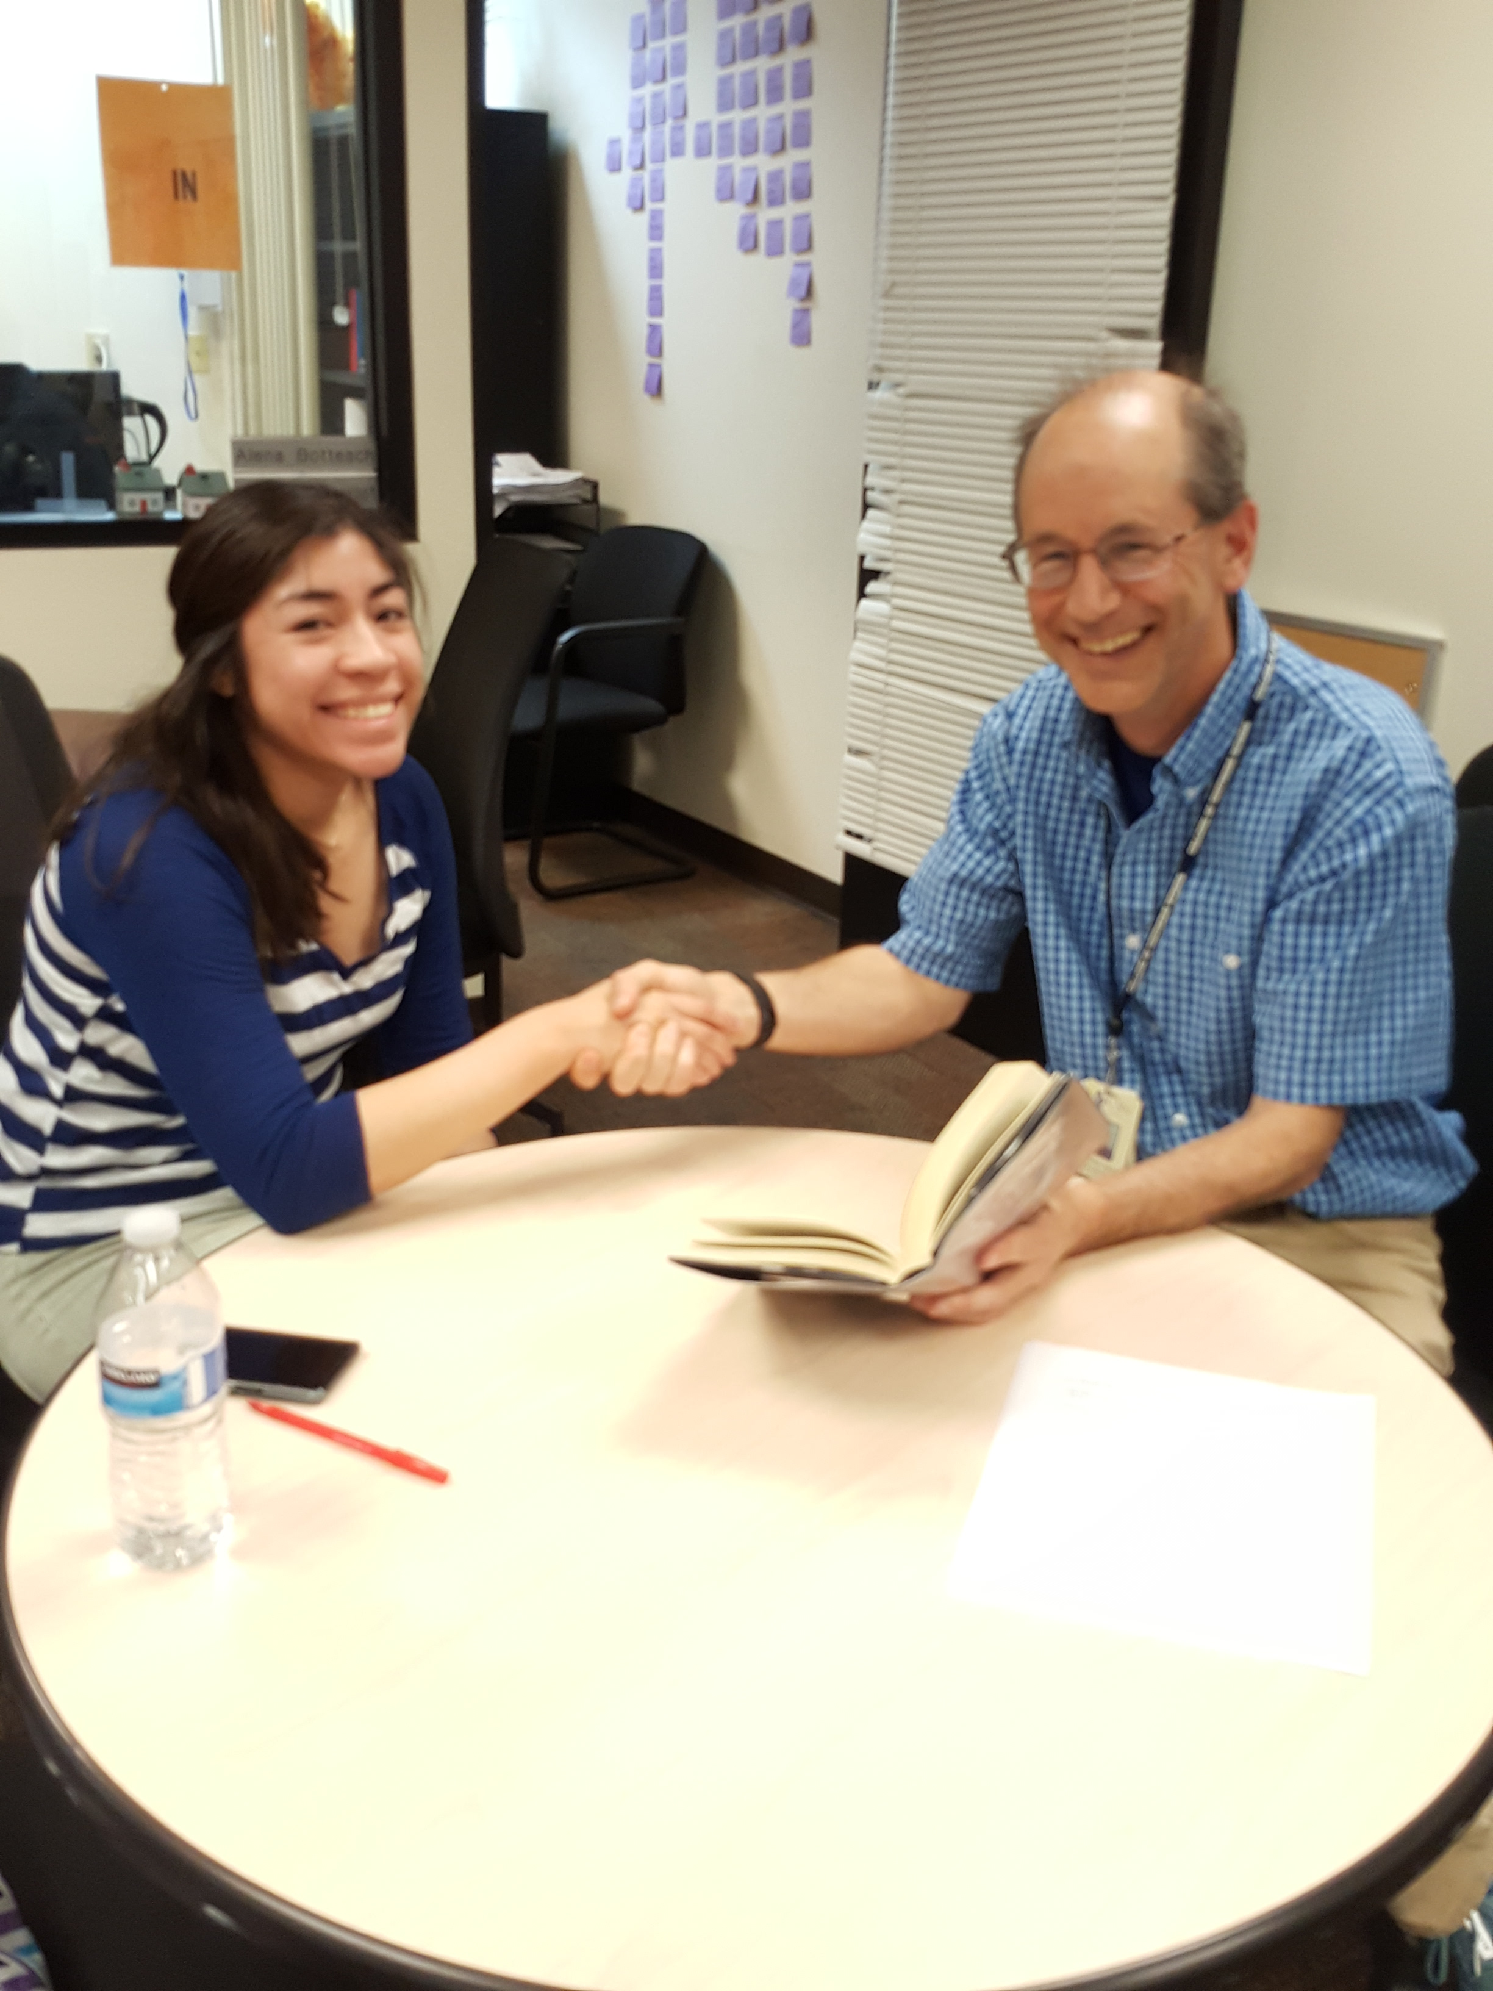
What Happens Outside the Classroom?
Dr. Peter T. Legner
College of Southern Nevada
peter.legner@csn.edu

Slide 24
FMOOWMP video

Slide 25
What students valued most highly in tutoring sessions was the climate; being treated well
The highest correlation for tutors for effective sessions was climate and student work prior to the session
The highest correlation for me for effective sessions was student work prior to the session

